Slide 1
Unit -5
Critical thinking skills

Slide 2
UNIT-5 Critical Thinking Skills
5.1 What are Critical Thinking Skills
5.2 Significance of Critical Thinking
5.2.1. Problem-Solving
5.2.2. Decision-Making
5.2.3. Avoiding Manipulation
5.2.4. Effective Communication
5.2.5. Innovation
5.2.6. Personal Growth
5.2.7. Improved Emotional Intelligence
5.3 What is Lateral Thinking
5.4 Critical thinking vs Lateral thinking
5.5 Ways to improve Critical Thinking
Ask Questions
Evaluate Information
Consider Different Perspectives
Think Creatively
Practice Reflection
Develop Logical Reasoning
Be Open-Minded
Seek Feedback
Stay Informed
Challenge Yourself

Slide 3
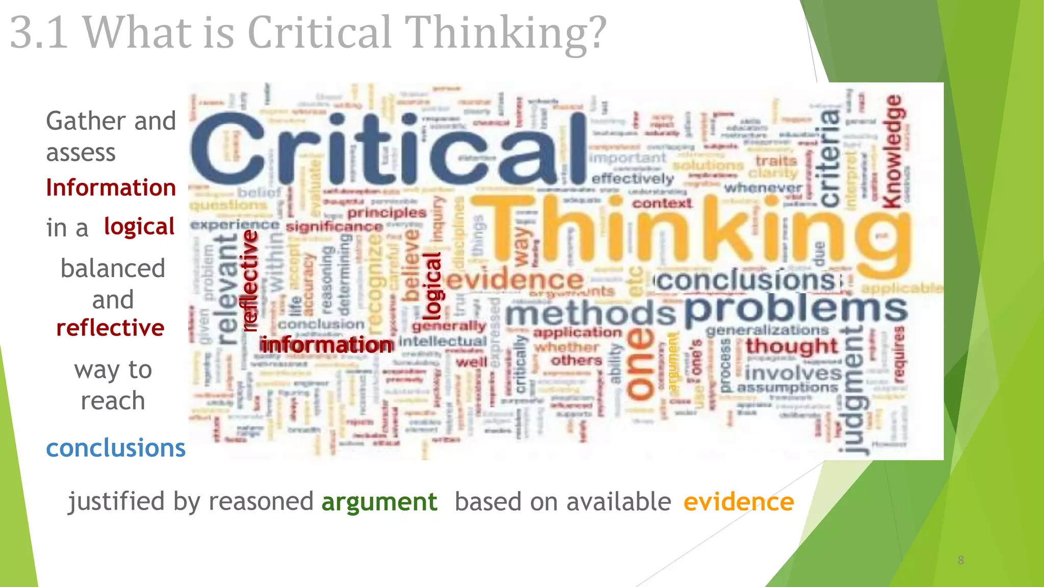

Slide 4
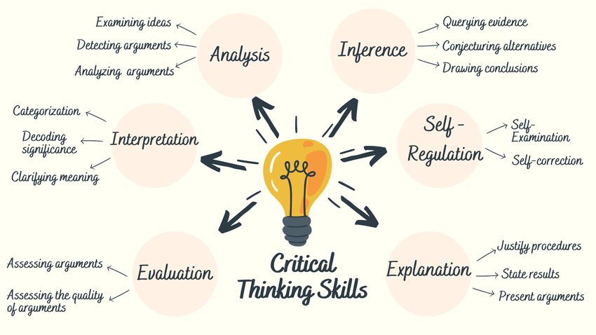

Slide 5
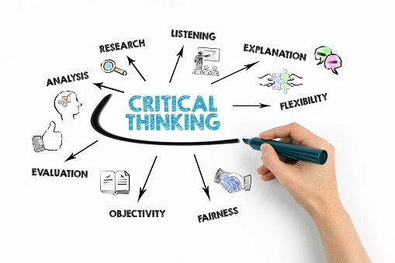

Slide 6
What is a critical thinking?
Critical thinking is the ability to interpret, evaluate, and analyze facts and information that are available, to form a judgment or decide if something is right or wrong. More than just being curious about the world around you, critical thinkers make connections between logical ideas to see the bigger picture.

Slide 7
5.2 Significance of Critical Thinking
The significance of critical thinking lies in its ability to enhance judgment, problem-solving, and decision-making, making it invaluable in both personal and professional contexts. Here’s why critical thinking is so essential:
Problem-Solving: Critical thinking enhances your ability to analyze complex situations, identify key issues, and develop effective solutions. It encourages a structured approach to break down problems, assess alternatives, and find the most efficient resolution.
Decision-Making: By critically evaluating information and considering multiple perspectives, critical thinkers make more informed and balanced decisions. This skill is crucial in personal and professional settings, allowing for decisions based on logic rather than emotions or biases.

Slide 8
Avoiding Manipulation:
Critical thinking helps individuals recognize biases, fallacies, and persuasive techniques used in media,
politics, and everyday interactions. This awareness protects them from being easily influenced or manipulated.
Effective Communication: Clear thinking leads to clear expression.
Critical thinkers are better at articulating their thoughts, presenting arguments coherently, and understanding
others' viewpoints, which improves interpersonal and professional communication.
Innovation: By questioning assumptions and exploring new ideas, critical thinkers foster creativity and innovation.
This skill is vital for generating novel solutions, improving processes, and advancing in any field

Slide 9
Personal Growth: Critical thinking promotes self-reflection and helps individuals recognize their
strengths, weaknesses, and areas for improvement. This fosters a mindset of continuous learning and growth.
Improved Emotional Intelligence: Critical thinkers are often better at understanding and managing
emotions—both their own and others'. This heightened emotional intelligence can lead to stronger relationships,
empathy, and resilience in challenging situations

Slide 10
5.3 What is Lateral Thinking
Lateral thinking is a term coined by Edward de Bono, a Maltese physician, psychologist, and author, to describe a method of problem-solving that involves approaching issues from a unique and unconventional perspective.
Unlike vertical or logical thinking, which follows a traditional step-by-step process, lateral thinking involves disrupting established patterns of thought and exploring creative, "sideways" solutions to problems.

Slide 11
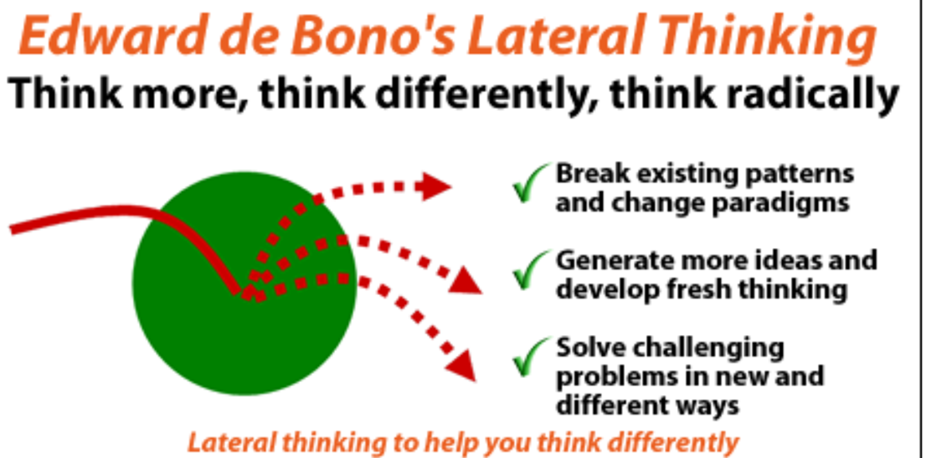

Slide 12
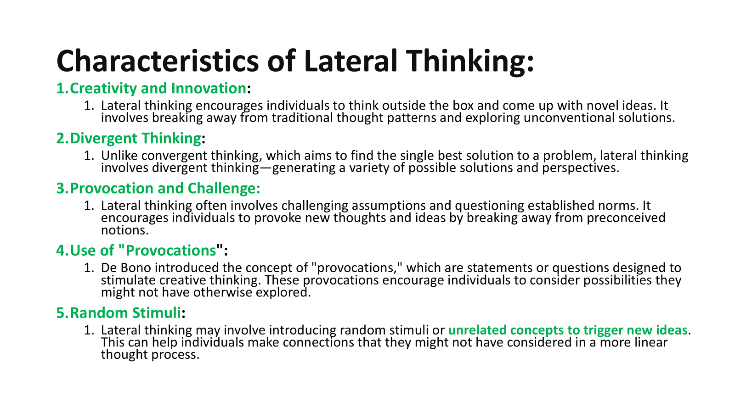

Slide 13
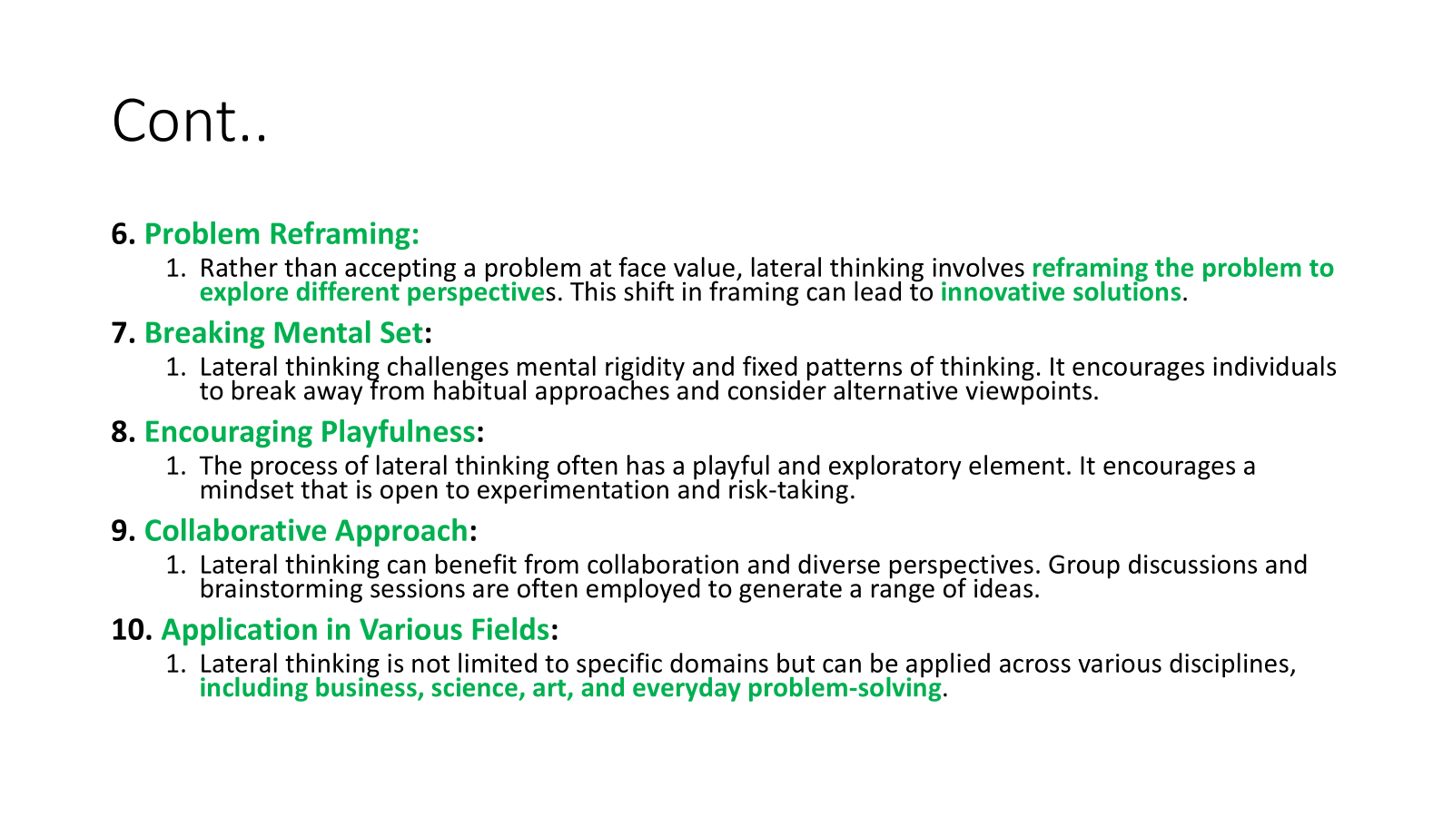

Slide 14
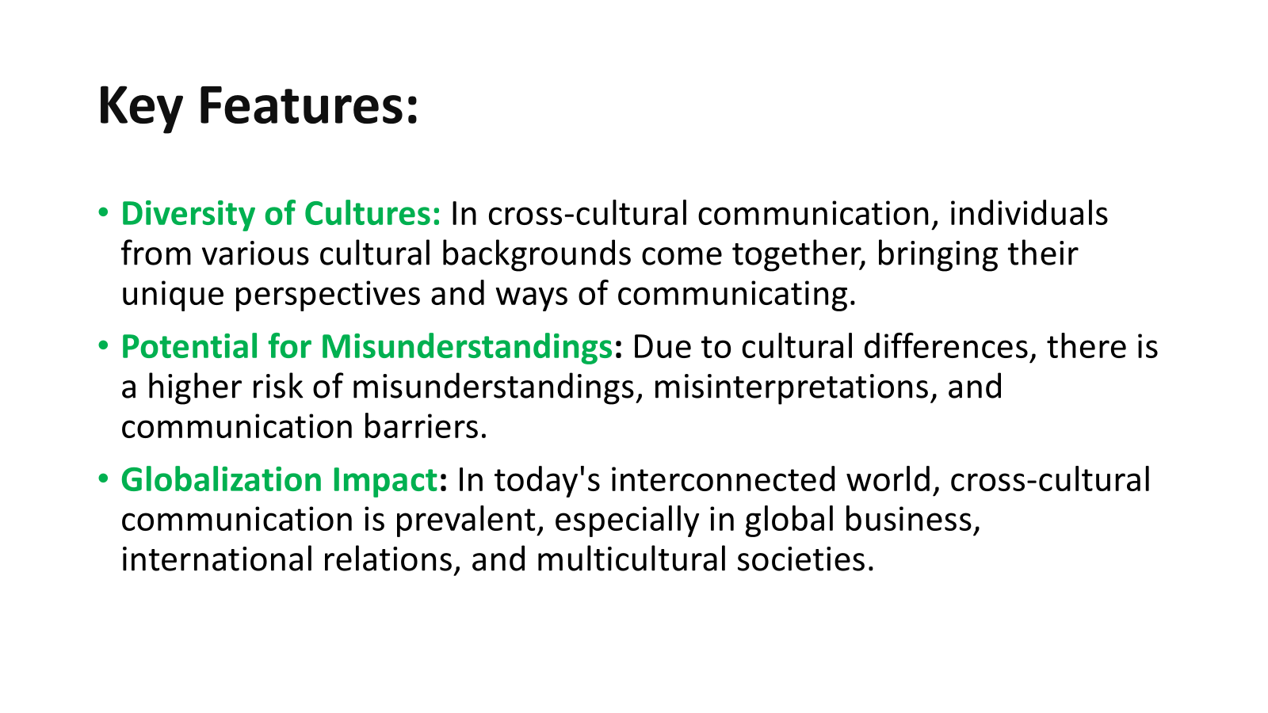

Slide 15
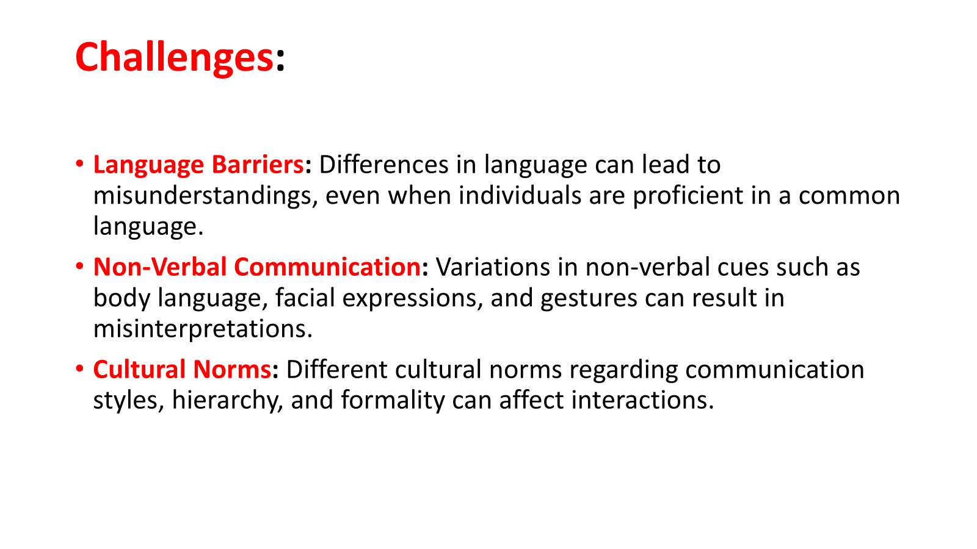

Slide 16
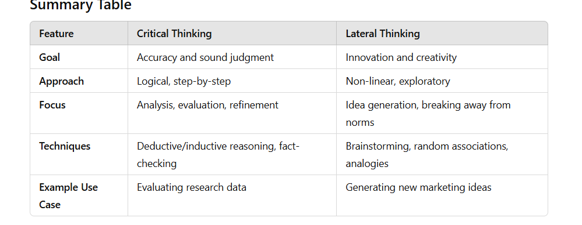
Critical thinking vs lateral thinking

Slide 17
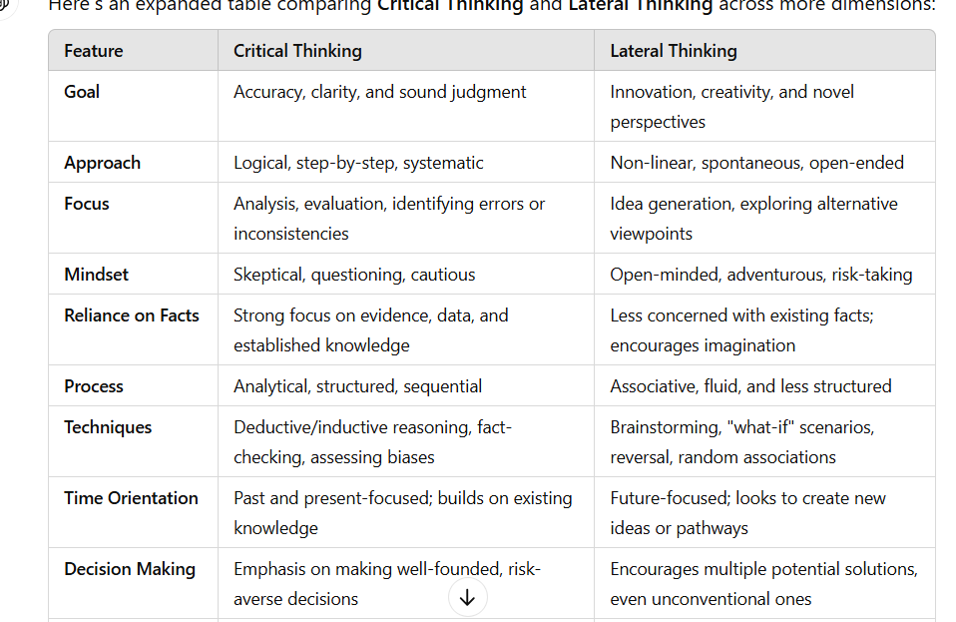

Slide 18
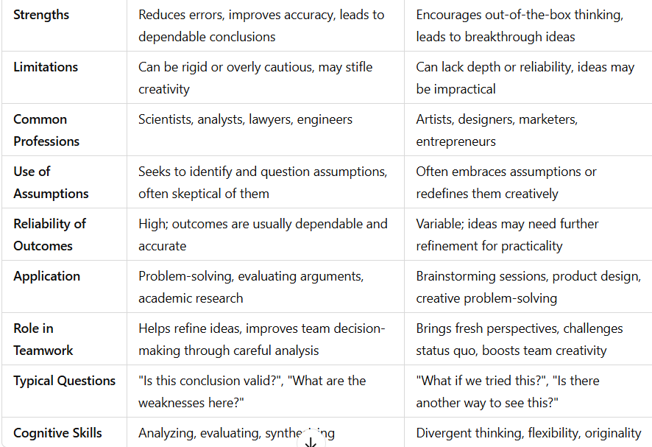

Slide 19
Ways to improve Critical Thinking
Ask Questions: Develop curiosity by asking questions to explore issues deeper.
Evaluate Information: Critically assess sources, facts, and evidence before accepting information.
Consider Different Perspectives: Look at situations from multiple viewpoints to avoid biases.
Think Creatively: Use creativity to find alternative solutions and broaden your thought process.
Practice Reflection: Reflect on your thoughts and decisions to understand your reasoning.
Develop Logical Reasoning: Strengthen your ability to form logical connections and conclusions.
Be Open-Minded: Stay receptive to new ideas and willing to change your views if needed.
Seek Feedback: Get others’ opinions to spot areas for improvement and refine your thinking.
Stay Informed: Keep learning and stay updated on current knowledge and developments.
Challenge Yourself: Take on difficult tasks or explore new subjects to push your cognitive limits.

Slide 20
Thank You

